Slide 1
The value of multidisciplinary perspectives
SURF 2018 / viterbo university
Dr. Beth Marzoni

Slide 2
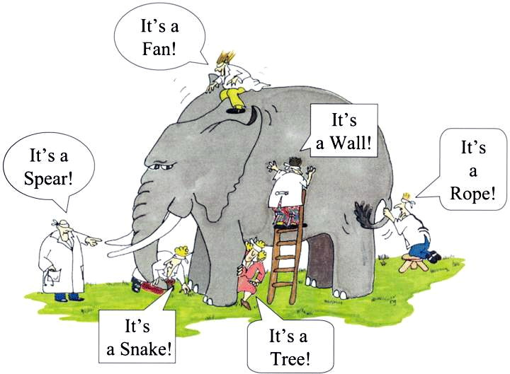

Slide 3
Brainstorm.

Slide 4


Slide 5
Brainstorm.

Slide 6
What does it mean to be interdisciplinary?
"Interdisciplinary research is a mode of research by teams or individuals that integrates information, data, techniques, tools, perspectives, concepts, and/or theories from two or more disciplines or bodies of specialized knowledge to advance fundamental understanding or to solve problems whose solutions are beyond the scope of a single discipline or area of research practice."
*Committee on Facilitating Interdisciplinary Research, Committee on Science, Engineering, and Public Policy (2004). Facilitating interdisciplinary research. National Academies. Washington: National Academy Press, p. 2.

Slide 7
Why is interdisciplinary thinking & research important?
Complex problems demand complex solutions.
Interdisciplinary work breaks down barriers.
Collaboration refines key skills.
It’s fun, gosh darn-it.

Slide 8
How do you know it’s working?
You should find yourself asking new questions—ones that you never would have asked otherwise.
You might discover new applications—and often in new disciplines or contexts.
You might be forced to revise your theoretical framework as your set of assumptions and principles that guide your research may be challenged and changed.

